Slide 1
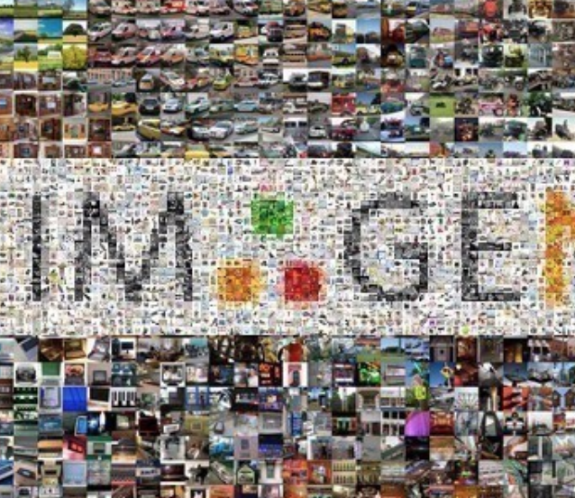
Artificial Intelligence For NLP Lesson-03
人工智能与自然语言处理课程组
2020.01. 20

Slide 2
Outline
Machine Learning
Background
Main Methodologies
Current Trends
Underfitting and Overfitting
Bias and Variance
Model Capacity
Underfitting and Overfitting
Train set, test set, validation set
Influence of dataset
The relation of train, test and validation.

Slide 3
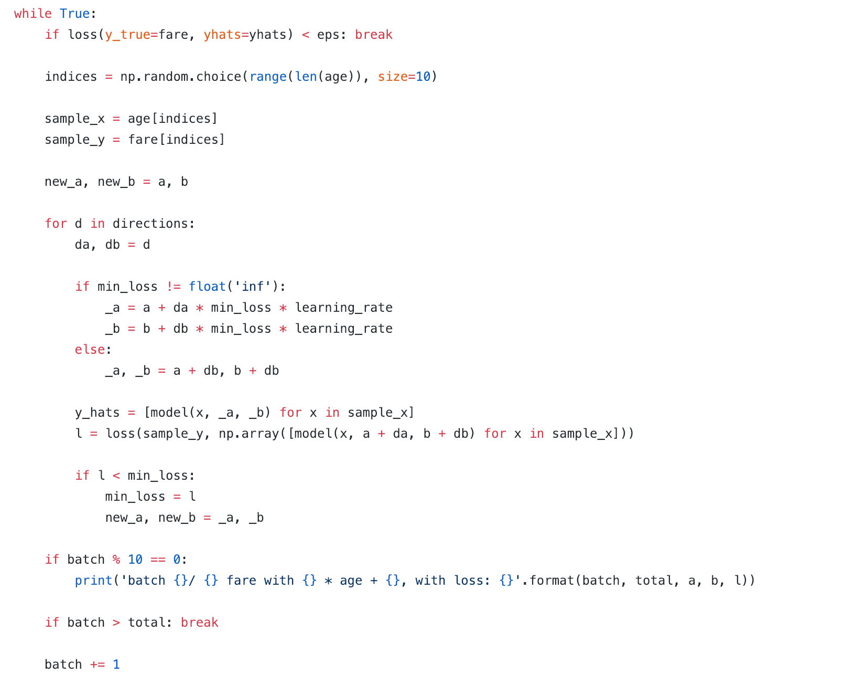
Review

Slide 4
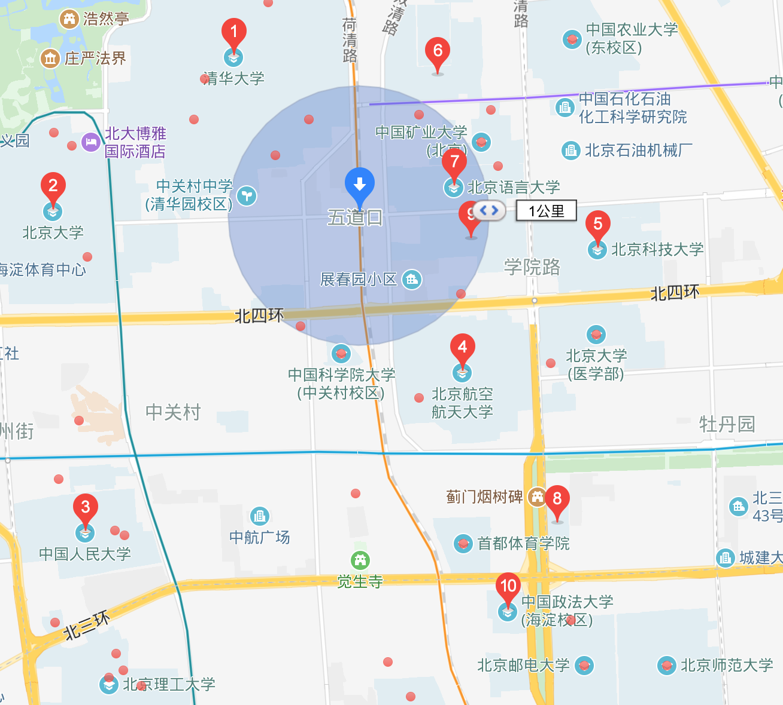
Example Driven

Slide 5
Target
More sales, More money.

Slide 6
Decision
1. Looking for a book
if there is holding a ceremony
how may days
female vs male
The closet college
..
2. Target: Which college should I go to?

Slide 7
Decision
1. Looking for a book
if there is holding a ceremony
how may days
female vs male
The closet college
..
2. Target: Which college should I go to?
Features
Model
y

Slide 8
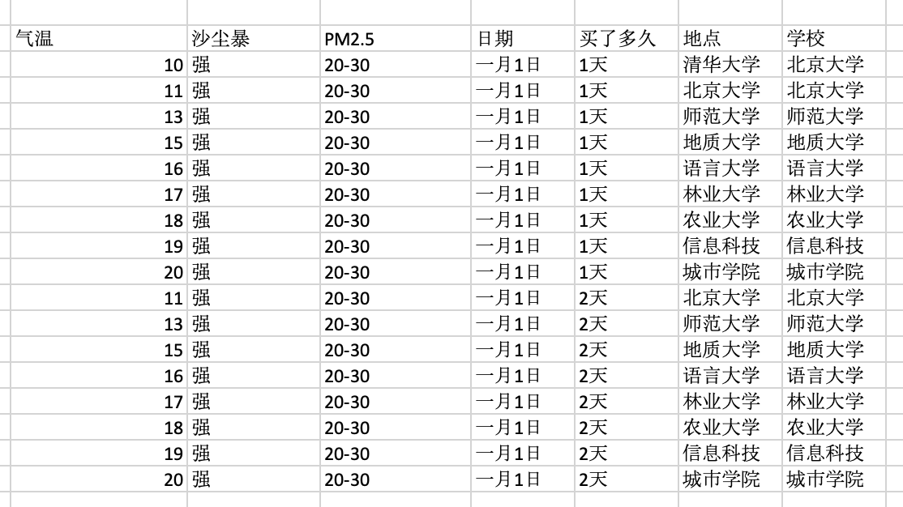
The First Book
Advantage?
Disadvantage?

Slide 9
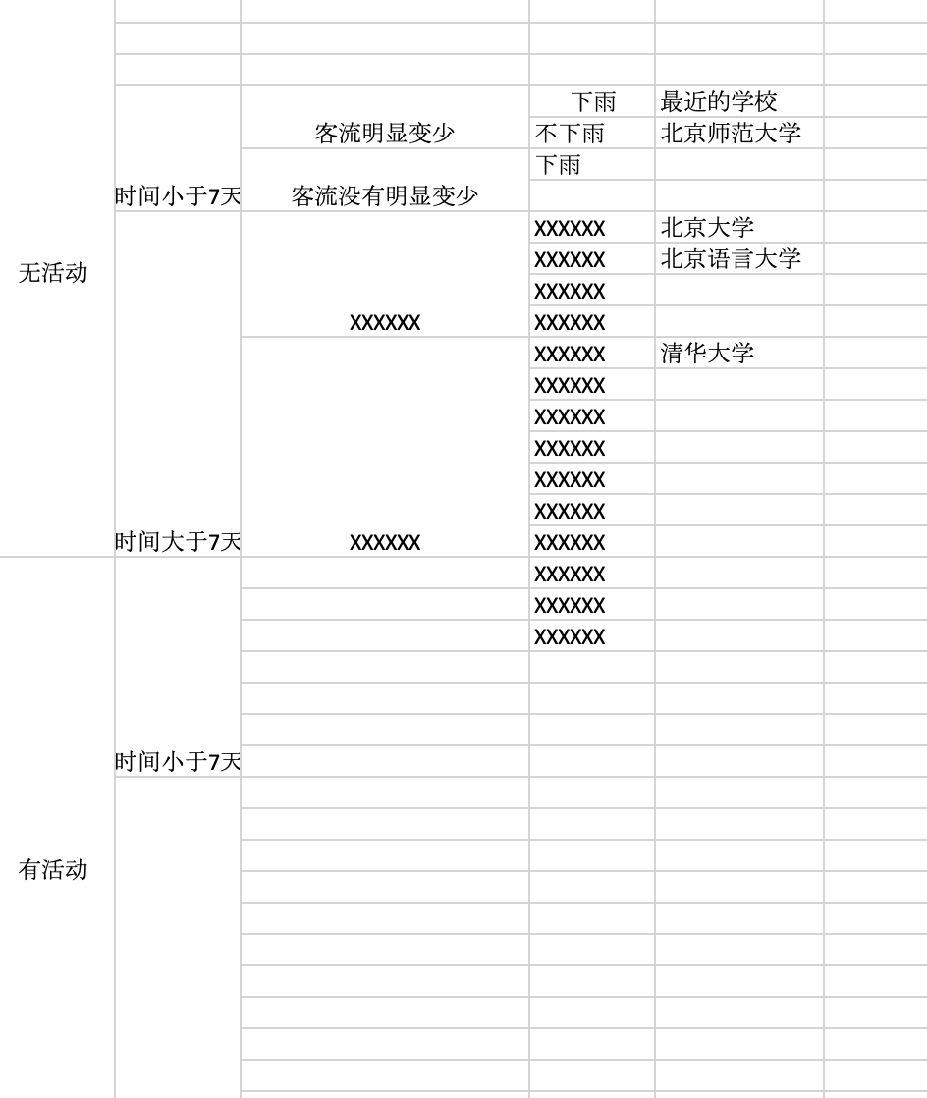
The second book

Slide 10
The First Book
Advantage?
Quick Inference
Easy Computing
….
Disadvantage?
Heavy
…
K-nearest neighbors

Slide 11
The second book
Decision Tree

Slide 12
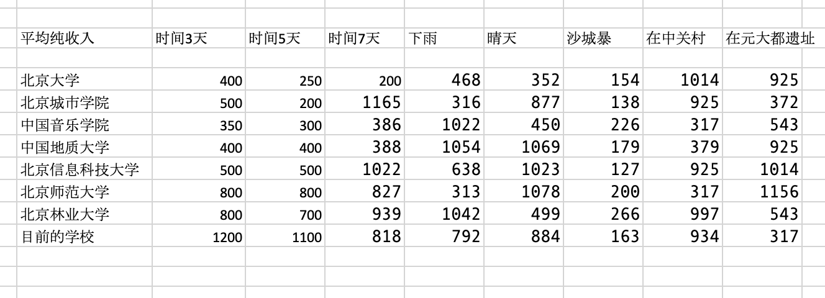
The third book

Slide 13
The third book
P（U|A1, A2, A3）
~ P(A1|U) * P(A2|U) * P(A3|U)
Naïve Bayesian Classification

Slide 14
The Forth book
食堂打饭 不标价钱， 问， 每种菜多少钱?
第一次 茄子*2 + ⻄⽠*1 + 馒头 * 1 : 7.8元
第二次 茄子*1 + ⻄⽠*1 + 馒头 * 2 : 6.5元
第三次 ⽟⽶*1 + 菠菜*2 + 馒头 * 1: 5.6元
...
每种价格?
Neural Network

Slide 15
Chat
Determine if is a valuable customer in Wechat?
What Features do we need?
How to predicate it?

Slide 16
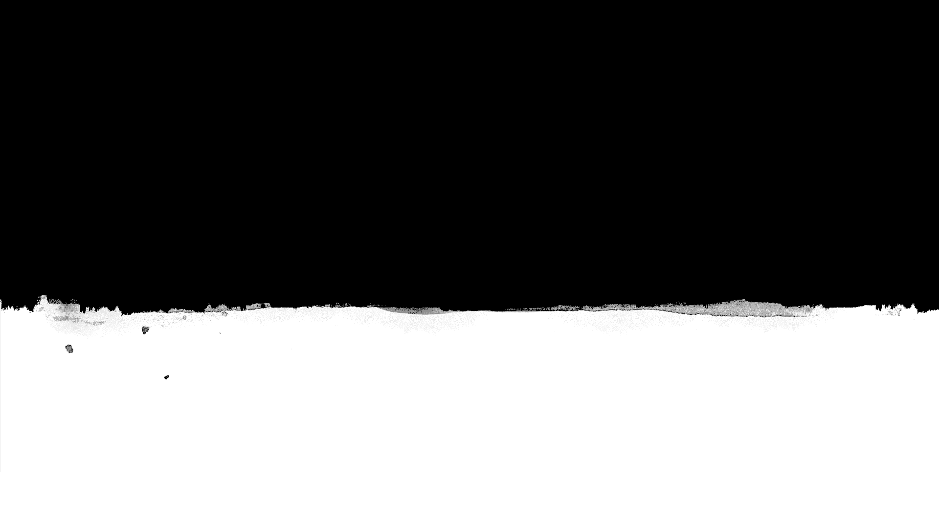
Two Type
1. Classification
2. Regression

Slide 17
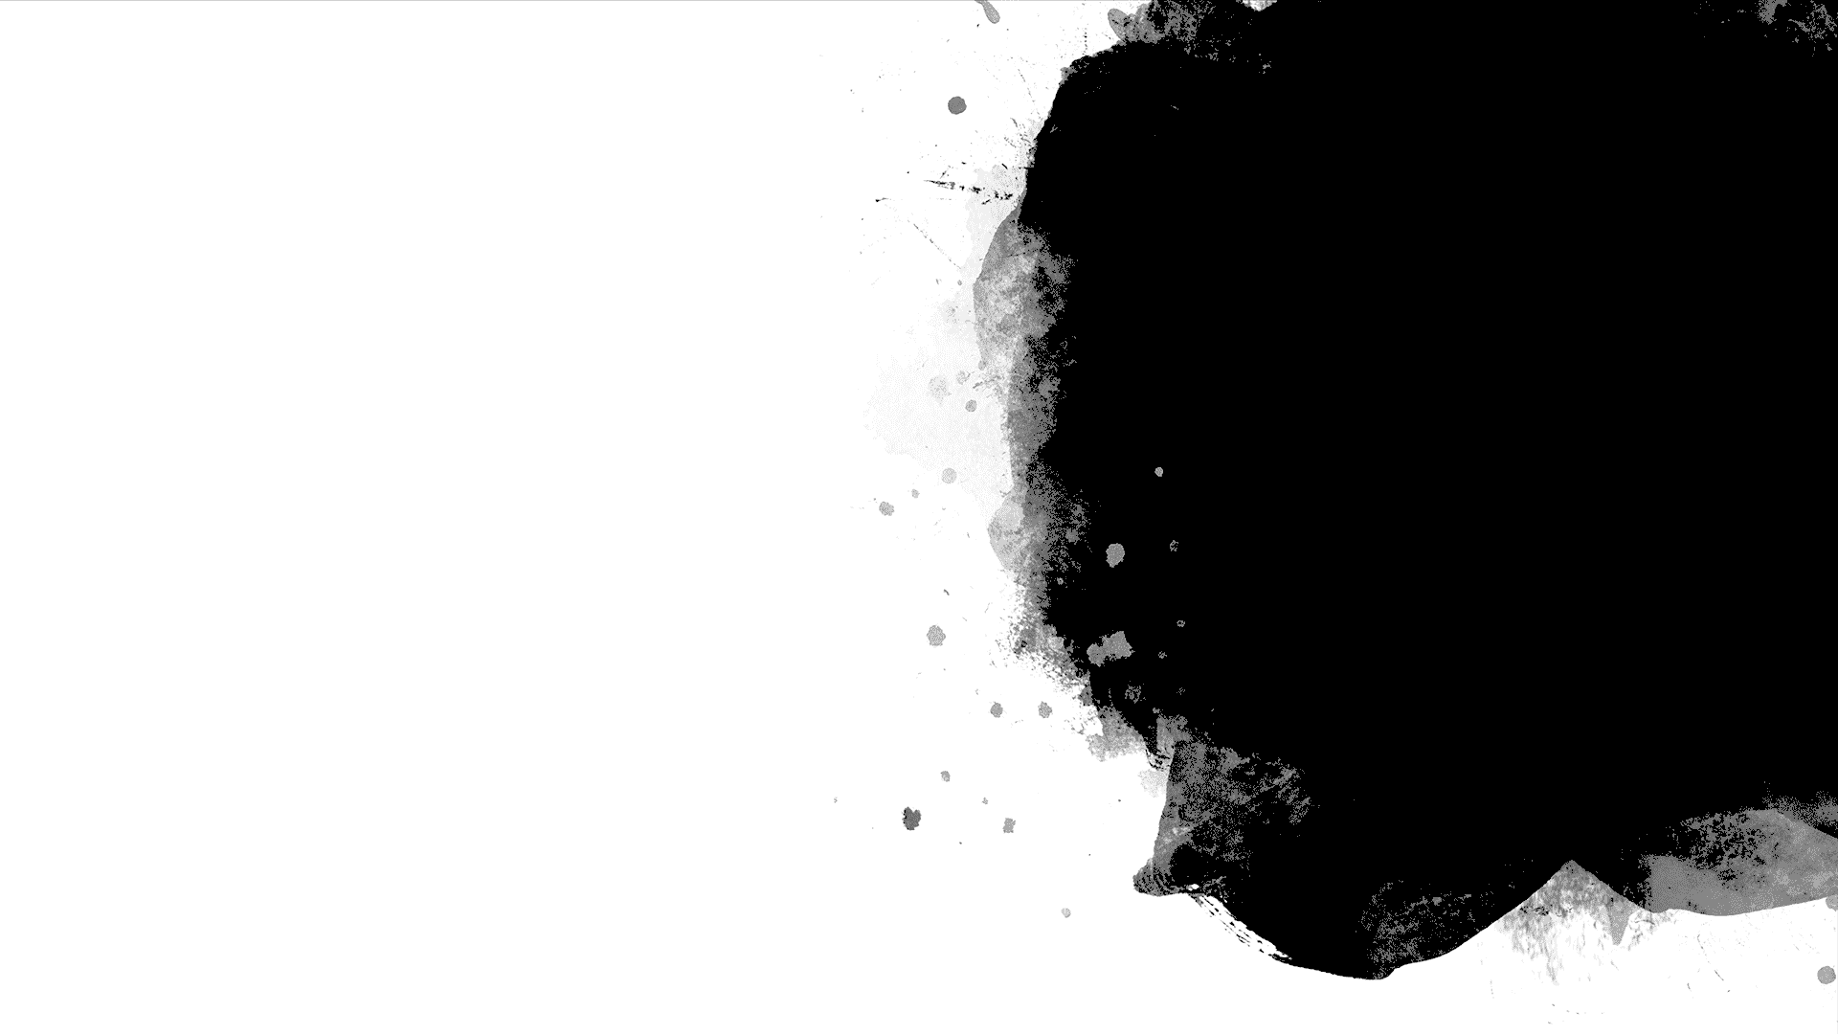
Cluster

Slide 18
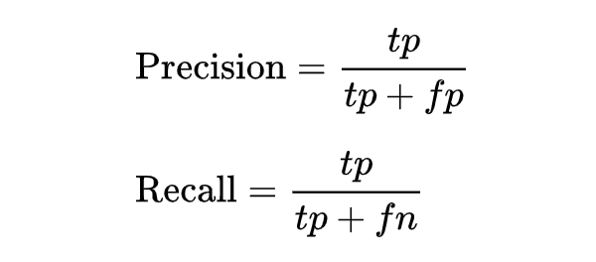
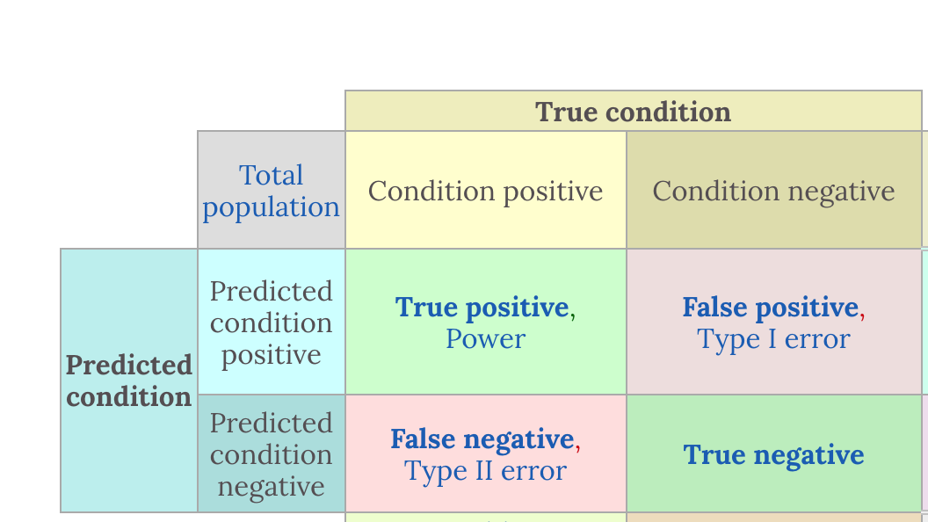
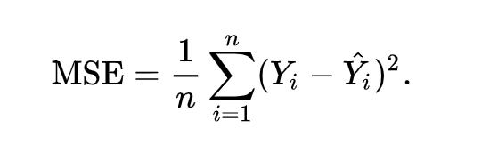
How to evaluate?
Accuracy
Precision
Recall
AOC/AUC
F1_score, F2_score
MSE
Loss Function
Generation
F1 = 2 * (precision * recall) / (precision + recall)

Slide 19
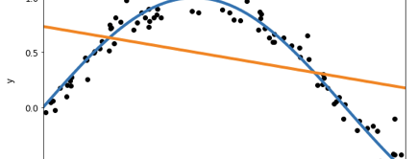
Overfitting & Underfitting
Why?

Slide 20
Lazy-Learning and Eager Learning
Lazy Learning: Target function will be approximately locally;
Dataset with few attributes.

Slide 21
Outliner
What’s outliner and how to detect?
Percentile

Slide 22
Bias and Variance
dilemma
The bias is an error from erroneous assumptions in the learning algorithm. High bias can cause an algorithm to miss the relevant relations between feature and target outputs. (underfitting);
The variance is an error from sensitivity to small fluctuations in the training set. High variance can cause an algorithm to model the random noise in the training data, rather than the intended outputs (overfitting).

Slide 23
Train, validation, test
Good Memory V.S Good Learning

Slide 24
Train, validation, test
Good Memory V.S Good Learning

Slide 25
Assignment
作业在我们的Jupyter Notebook中
1. Summarize the reasons of overfitting and underfitting. Put them in github repository.
2. Implement the absolute value loss function in Linear Regression Model;
3. and other coding practice and QA problems.

